Slide 1

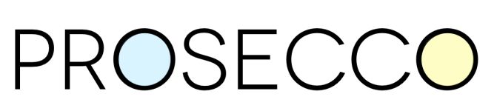
More Secure Software Systems by Formal Verification, Property-Based Testing, Secure Compilation, and Dynamic Monitoring
Cătălin Hrițcu
Inria Paris, Prosecco team
Prosecco Reading Group - Friday, November 29, 2013
TexPoint fonts used in EMF.
Read the TexPoint manual before you delete this box.: AAAA

Slide 2
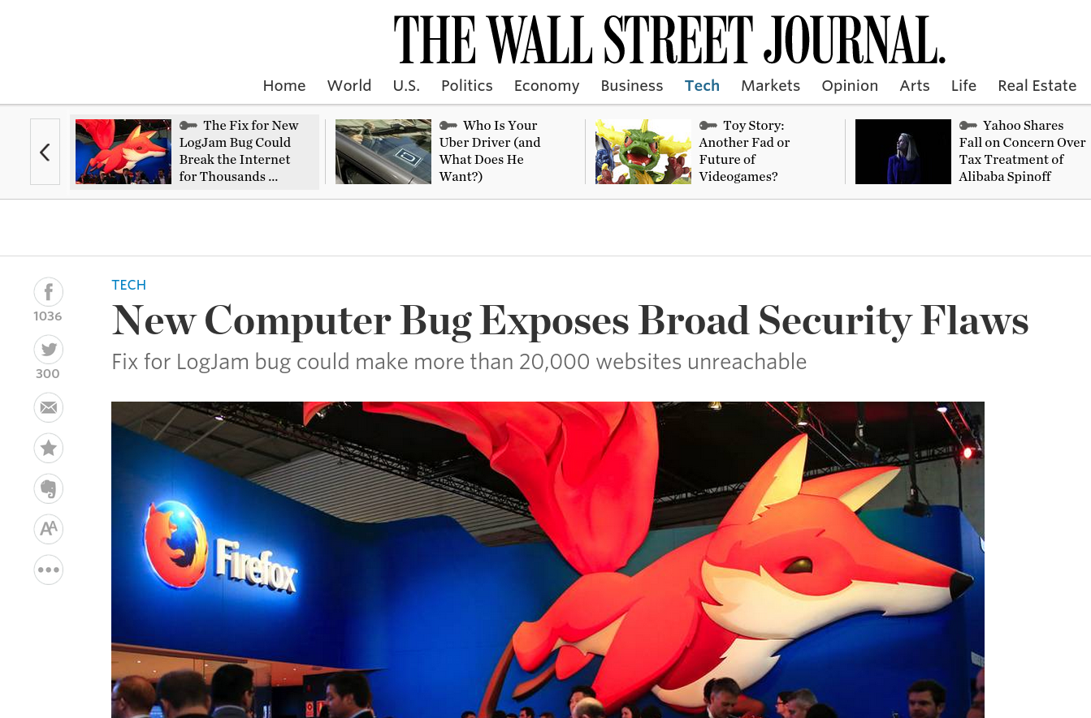
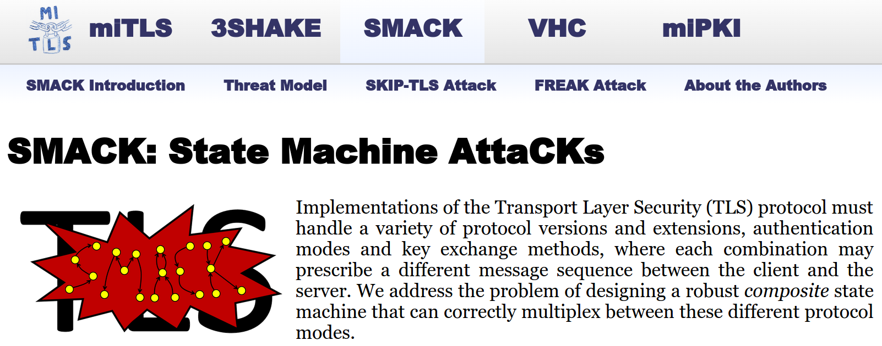
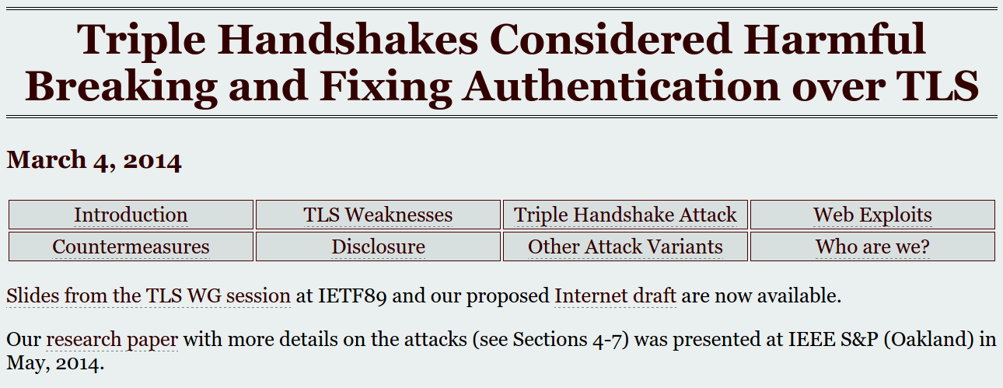
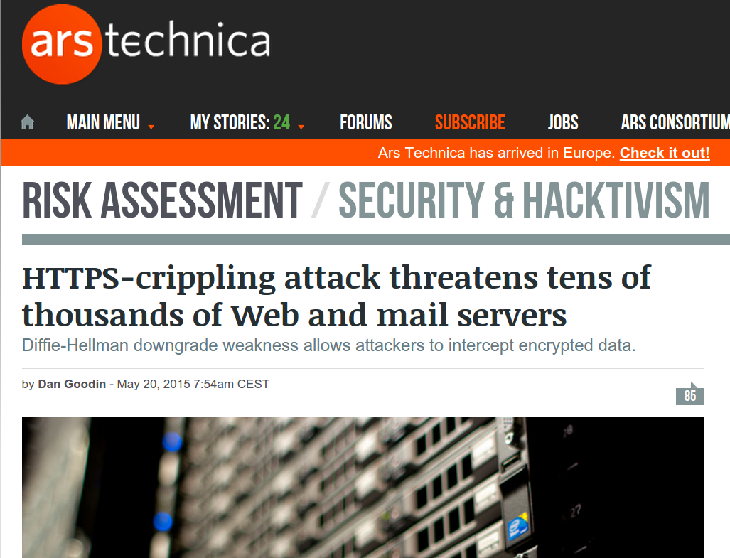
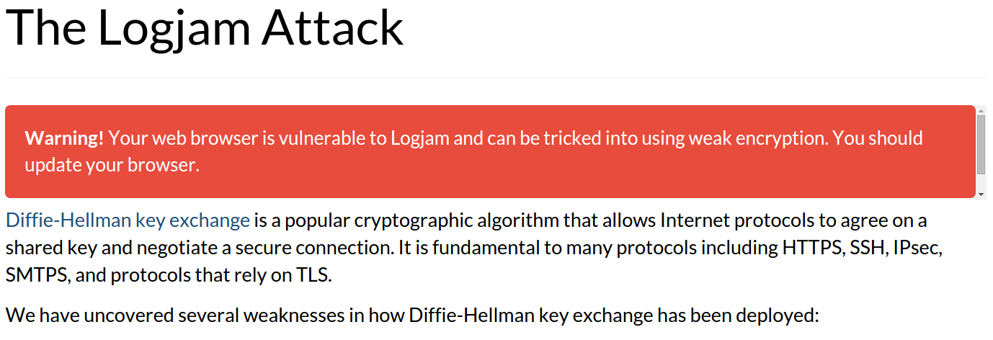
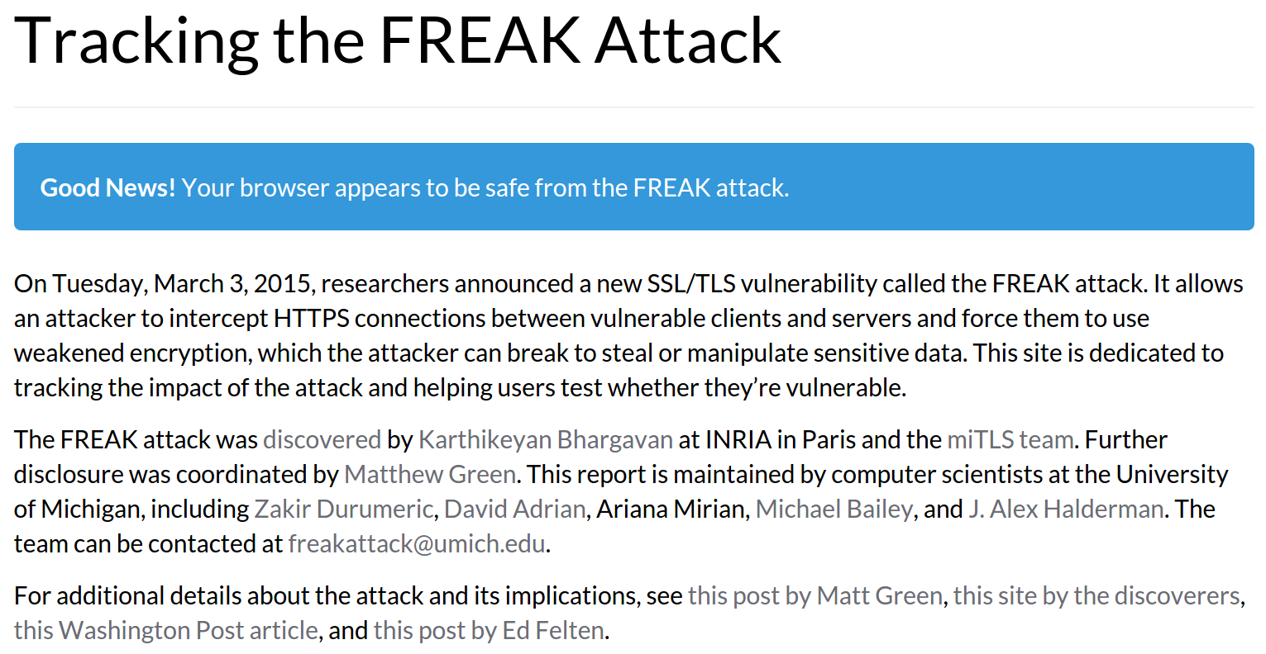
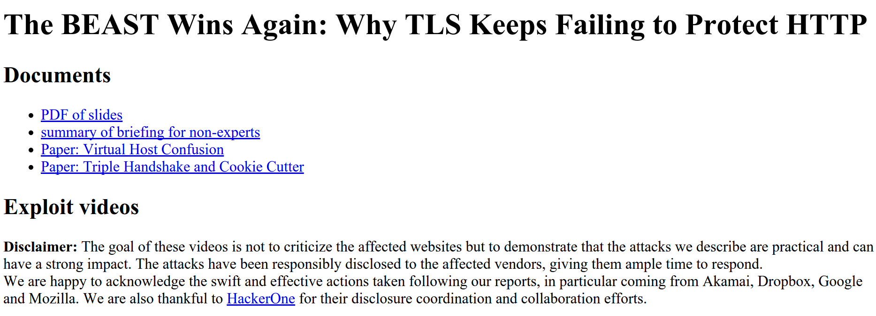
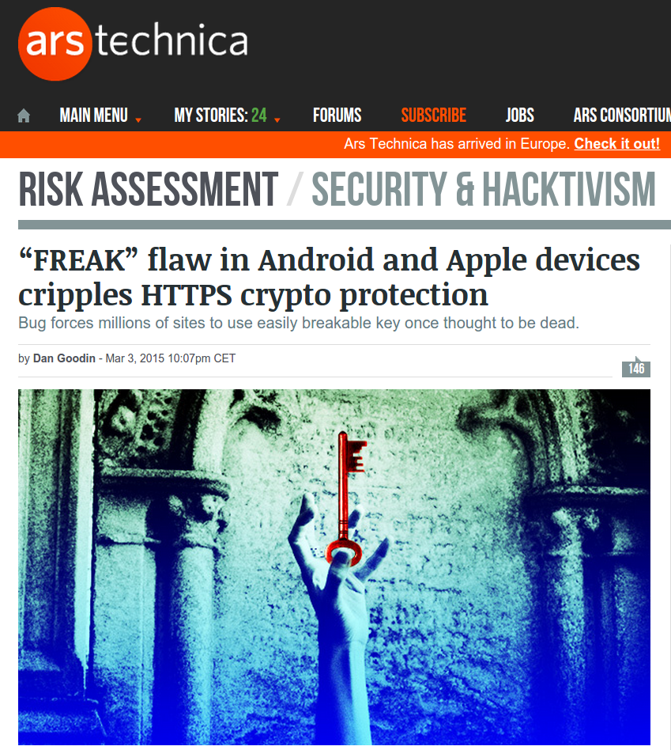
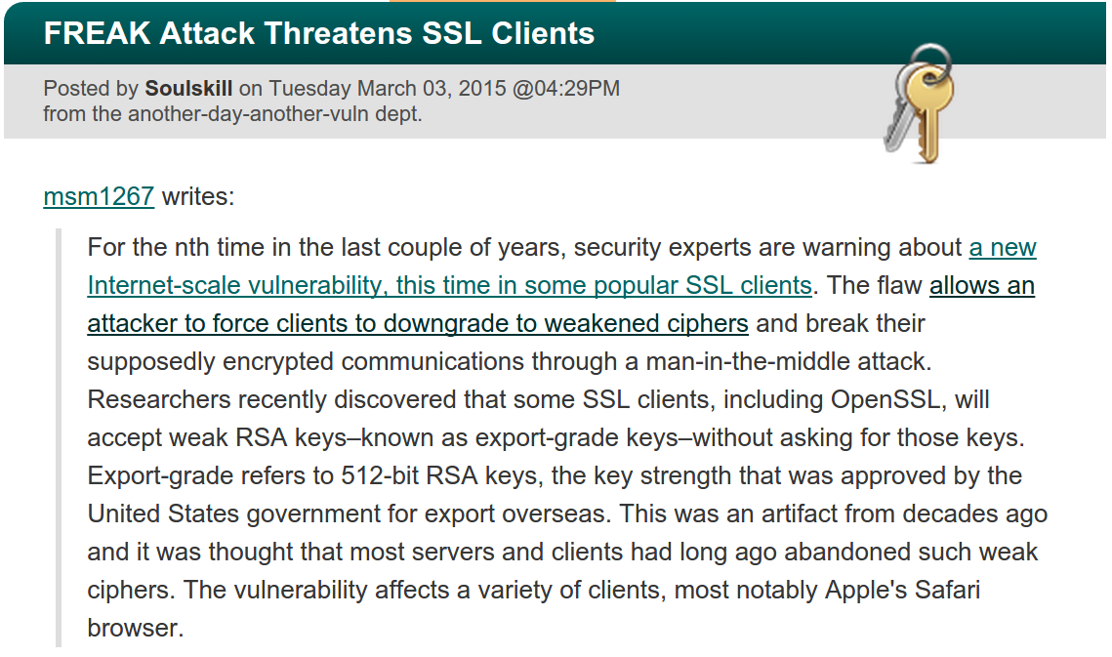
Software [in]security is a big problem
e.g. vulnerabilities in TLS (Prosecco)
Notes:
Bugs both in the protocol and it’s implementation

Slide 3
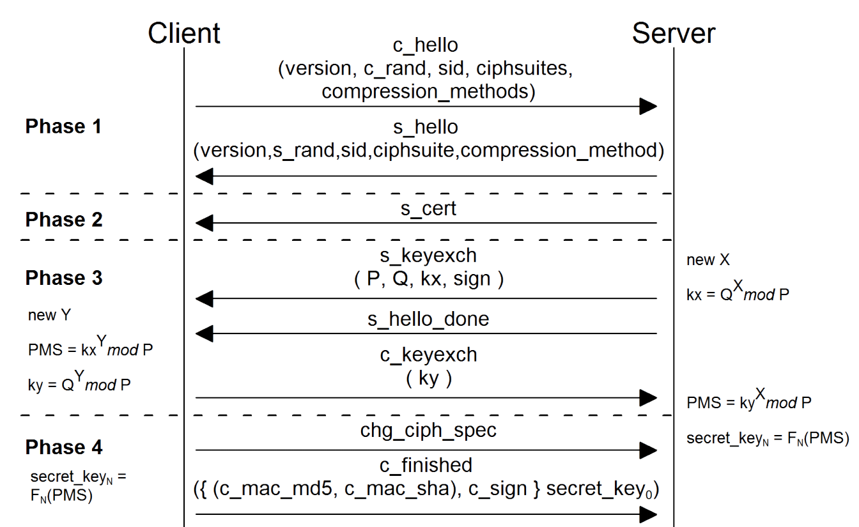
Formal verification can help
… find bugs & prove security
ProVerif & CryptoVerif
Prosecco tools for automatically analyzing the security of crypto protocol models
successful for finding logical flaws early in protocol design phase
Just that models are very abstract
previous proofs of TLS models missed implementation attacks
Verified models are cool
but verified implementations are much coolear
Notes:
diagram: instead of drawing diagrams like this on your board, you write them in a process calculus and then analyze them

Slide 4

Verifying implementations with
F* is a new programming language
… putting together:
impure functional programming in ML
extracts to OCaml and F#, interoperates
the automation of SMT-based verification systems
like in Why3, Frama-C, Boogie, VCC, Dafny
the expressive power of interactive proof assistants based on dependent types
like in Coq, Agda, or Lean

Slide 5
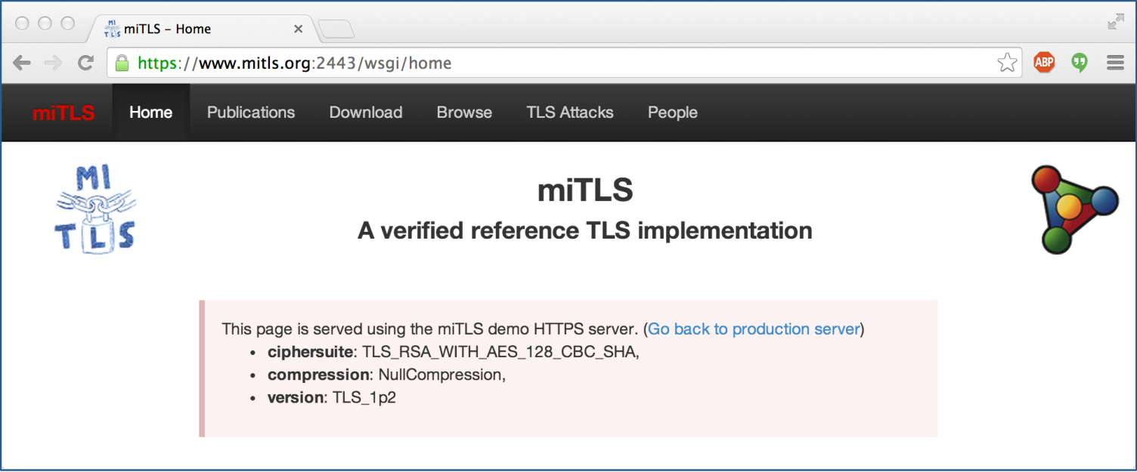
miTLS*
Formally verified reference implementation of TLS 1.2 in F* (working towards TLS 1.3)
Written from scratch focusing on verification

Slide 6
The limits of formal verification
scalability
state of the art for verifying correctness and security of systems is 10.000-20.000 LOC (and 500.000 LOP)
legacy code (e.g. OpenSSL)
vs nice fresh reference implementations (e.g. miTLS*)
effort of failed proofs (automatic or interactive)
finding bugs by failed proof attempts very costly
can find very interesting bugs by testing

Slide 7
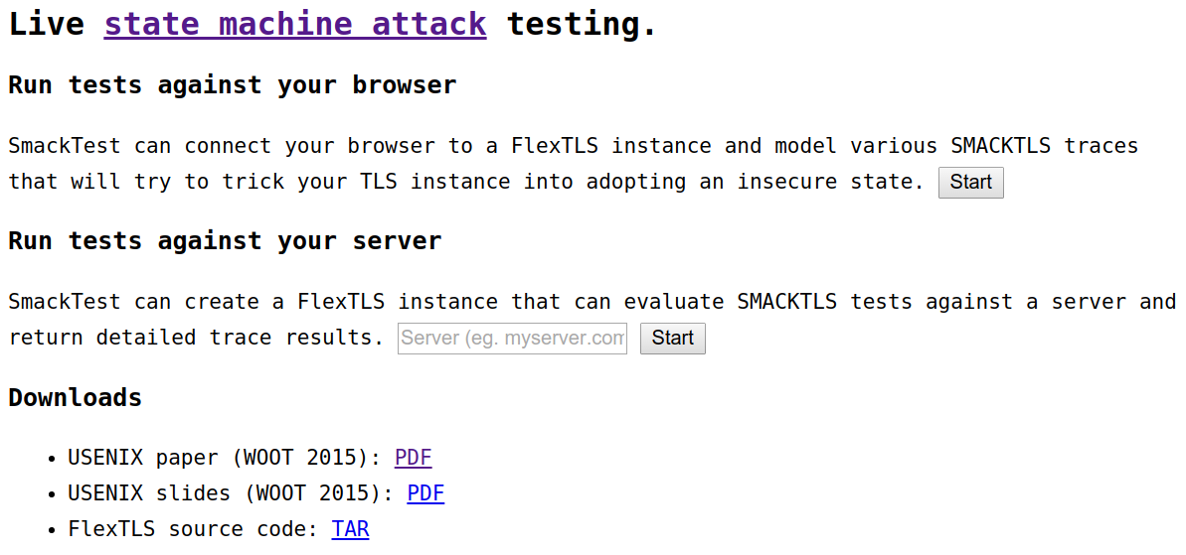
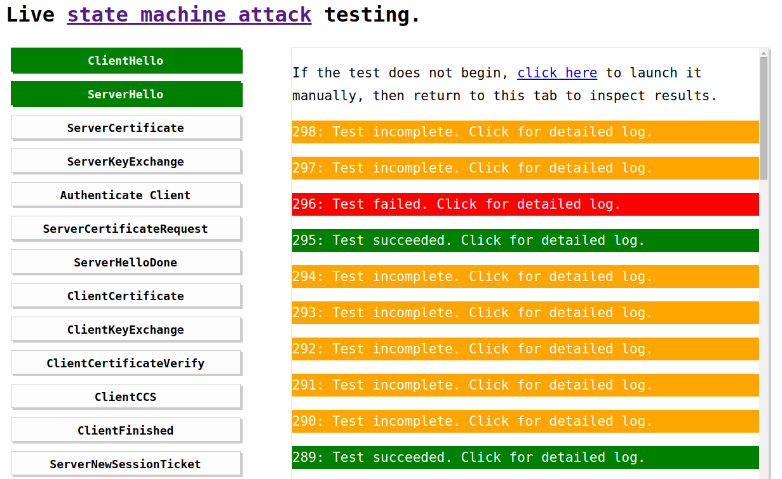
SMACKTest: testing TLS state machine
Notes:
TODO: Skipped most of this

Slide 8
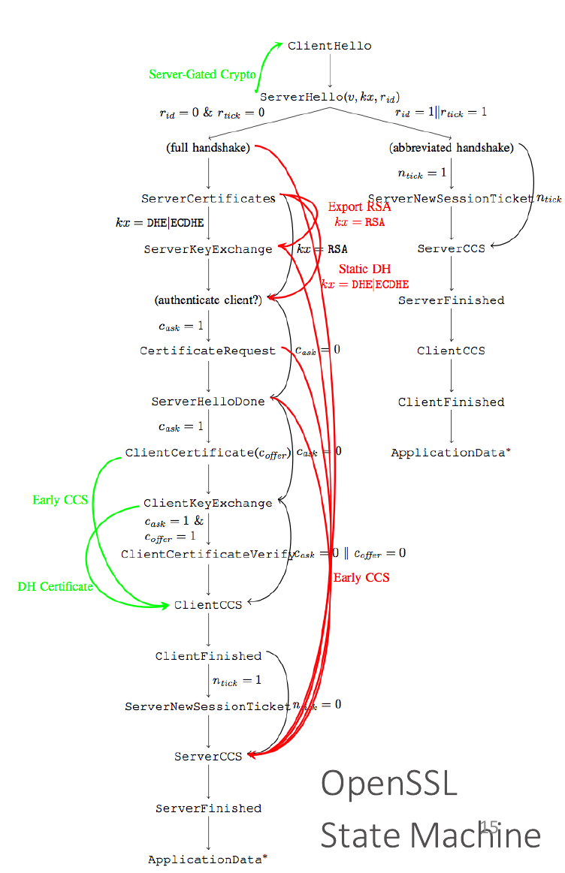
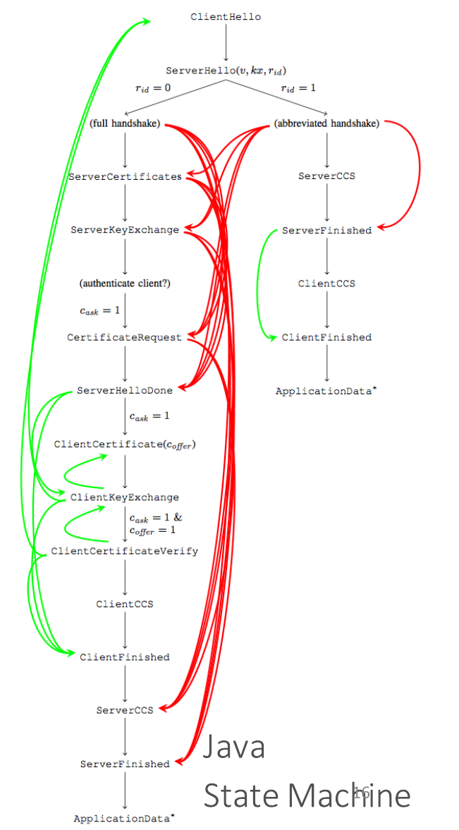
Notes:
Red: skipping
Green: allowing unexpected messages to be received

Slide 9
Dependable property-based testing
Beyond just finding bugs, confidence by testing
Integrating testing and formal verification
QuickChick: property-based testing for Coq (soon F* too)
i.e. putting the “property” back in property-based testing
Systematically measuring testing quality
Polarized mutation testing
i.e. property-based mutation
Making testing more thorough and cost-effective
Luck: a domain-specific language for data generators
i.e. property-based generation

Slide 10

Back to miTLS*
Ooops
OK we can thoroughly test this
OK we can verify this
Problem 1: insecure languages
15.000 LOC
50.000 LOC
400.000 LOC
F*
OCaml
C
ASM
compiled F*
compiled OCaml
compiled C
compiled ASM
Problem 2: insecure interaction
Notes:
end: We have 2 problems

Slide 11

Secure compilation
1. Secure language semantics (e.g. memory safe C)
2. Secure language interaction (dynamic isolation, call discipline, type checking, immutability, uniqueness, …)
But, at what cost? In software, 10x? 100x? 1000x?
Micro-policies
new tagged hardware architecture
associates large metadata tag to each word
efficiently propagates and checks tags; hw caching
dynamic monitoring: software defined, very flexible, fine-grained (words, instructions), fast …
… average 10% runtime overhead for complex policies!

Slide 12
More Secure Software Systems
Formal Verification
Property-Based Testing
Secure Compilation
Dynamic Monitoring
… they can all play a role!
Thank you!
Notes:
say: Hardware Accelerated Dynamic Monitoring

